Slide 1
Time complexity. Sorting
Yeskendir Sultanov

Slide 2
Time complexity and Space complexity
Sometimes, there are more than one way to solve a problem. We need to learn how to compare the performance different algorithms and choose the best one to solve a particular problem. While analyzing an algorithm, we mostly consider time complexity and space complexity. Time complexity of an algorithm quantifies the amount of time taken by an algorithm to run as a function of the length of the input. Similarly, Space complexity of an algorithm quantifies the amount of space or memory taken by an algorithm to run as a function of the length of the input.
Time and space complexity depends on lots of things like hardware, operating system, processors, etc. However, we don't consider any of these factors while analyzing the algorithm. We will only consider the execution time of an algorithm.

Slide 3
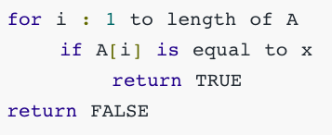
Let’s start with a simple example. Suppose you are given an array A and an integer x and you have to find if x exists in array A. Simple solution to this problem is traverse the whole array A and check if the any element is equal to x.
Each of the operation in computer take approximately constant time. Let each operation takes c time. The number of lines of code executed is actually depends on the value of x. During analyses of algorithm, mostly we will consider worst case scenario, i.e., when x is not present in the array A. In the worst case, the if condition will run N times where N is the length of the array A. So in the worst case, total execution time will be (N∗c+c). N∗c for the if condition and c for the return statement ( ignoring some operations like assignment of i).
As we can see that the total time depends on the length of the array A. If the length of the array will increase the time of execution will also increase.

Slide 4
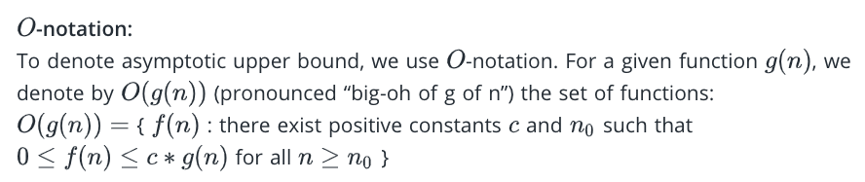

Slide 5
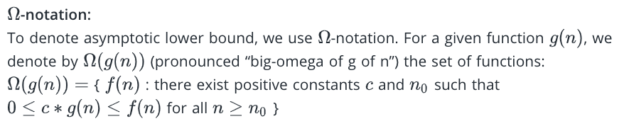

Slide 6
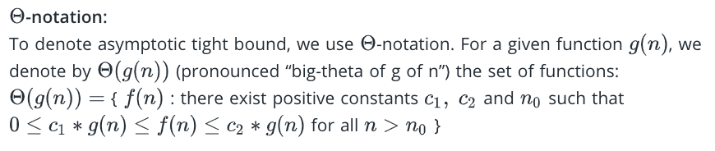

Slide 7
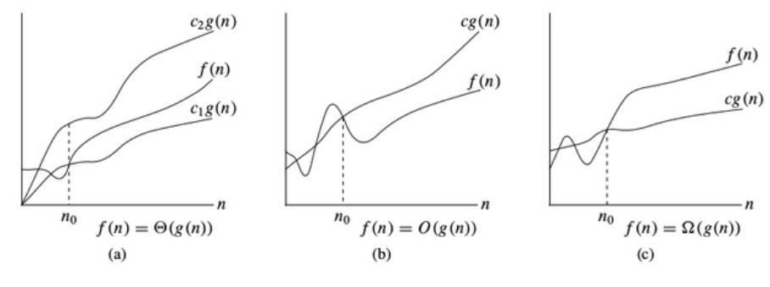
Time complexity notations

Slide 8
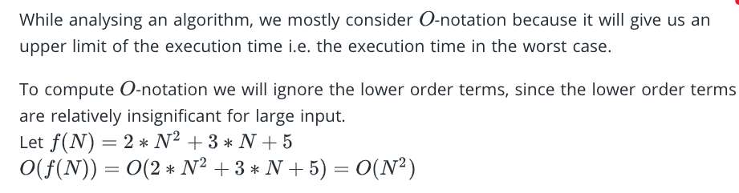

Slide 9
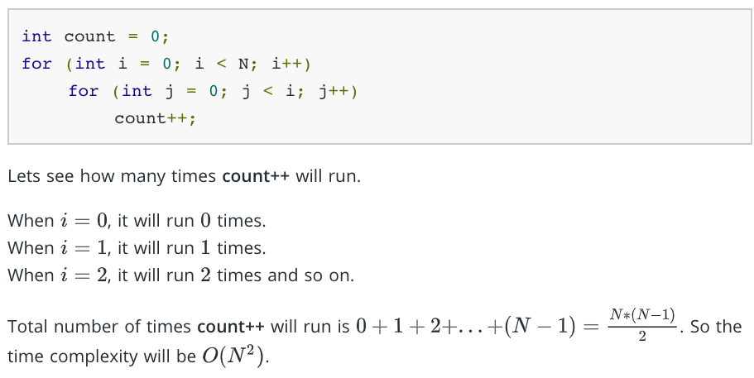

Slide 10
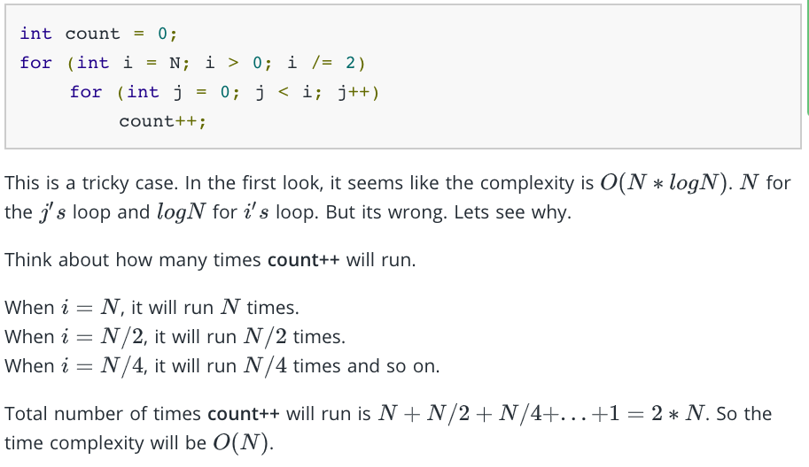

Slide 11
Time complexity is the time required to run the program. it can also be termed as the running time of the program. the increasing order of complexity is as follows:
constant-----O(1) [a simple hello world program]
logarithmic----O(logn) [for binary searches]
linear------O(n) [a program with no nested loops]
quadratic----O(n^2) [a program with two nested loops]
cubic-----O(n^3) [a program with three nested loops]
exponential----O(x^n),x=2,3,4....[generating subsets of a problem]
factorial--------O(n!) [finding out all possibilities or a permutation problem]

Slide 12
Sorting algorithms
Selection Sort
Bubble Sort
Insertion Sort
Merge Sort

Slide 13
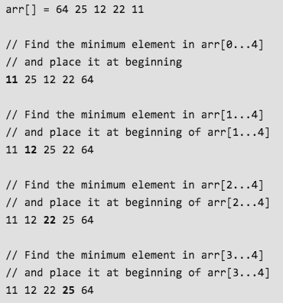
Selection Sort, Time Complexity O(N^2)
The selection sort algorithm sorts an array by repeatedly finding the minimum element (considering ascending order) from unsorted part and putting it at the beginning. The algorithm maintains two subarrays in a given array.
1) The subarray which is already sorted.
2) Remaining subarray which is unsorted.
In every iteration of selection sort, the minimum element (considering ascending order) from the unsorted subarray is picked and moved to the sorted subarray.
Following example explains the above steps:

Slide 14
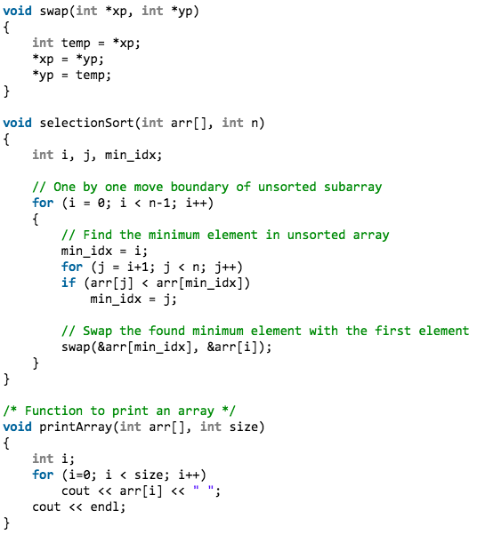
Implementation

Slide 15
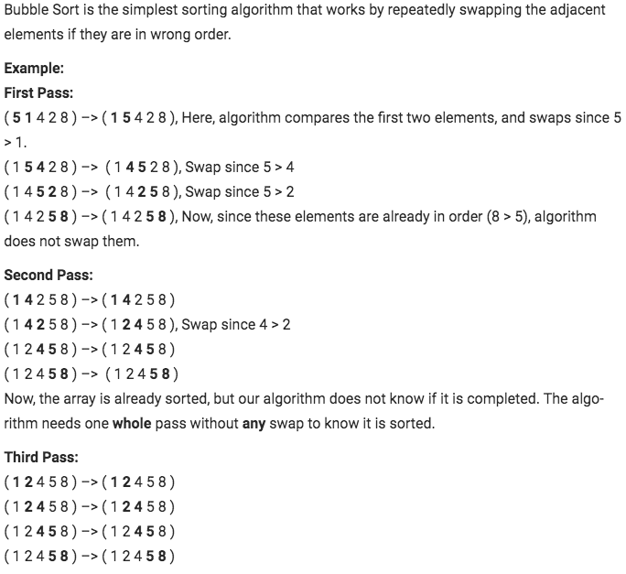
Bubble Sort,
Time Complexity O(N^2)

Slide 16
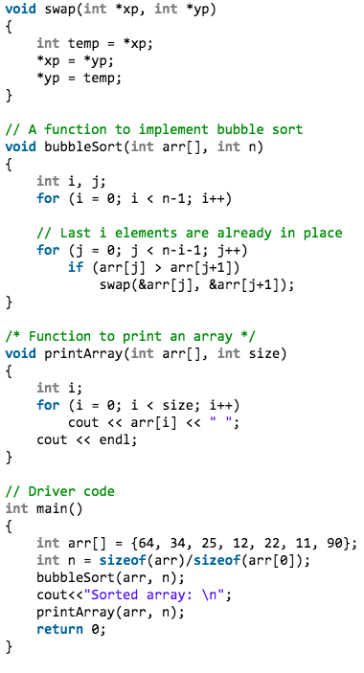
Implementation

Slide 17
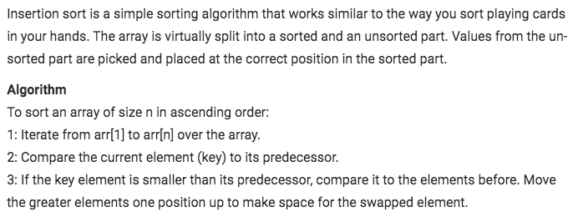
Insertion Sort, Time Complexity O(N^2)

Slide 18
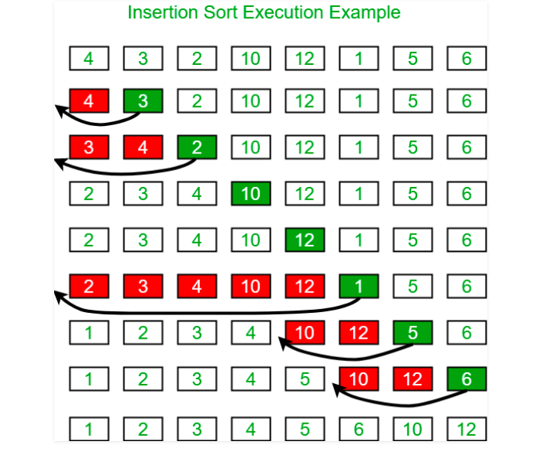
Example

Slide 19
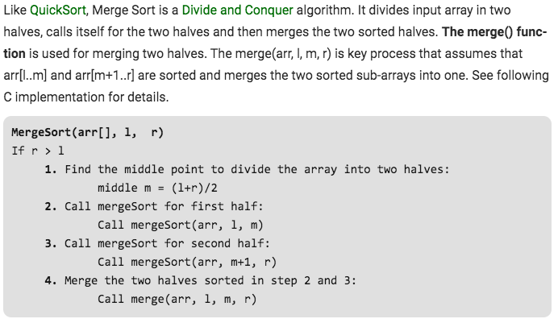
Merge Sort, Time Complexity O(N*log2N)

Slide 20
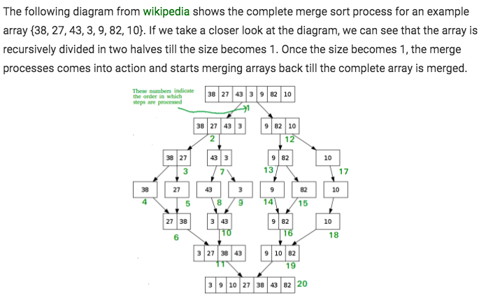

Slide 21
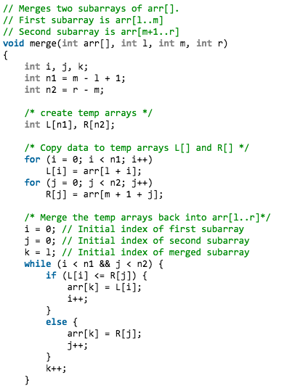
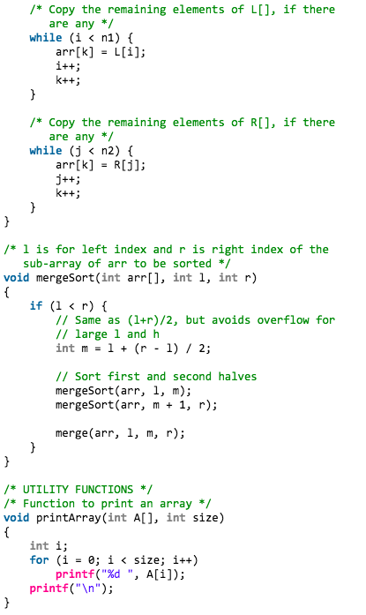

Slide 22
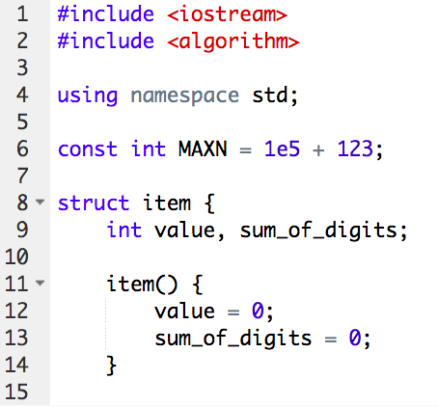
C++ STL Sort - 1

Slide 23
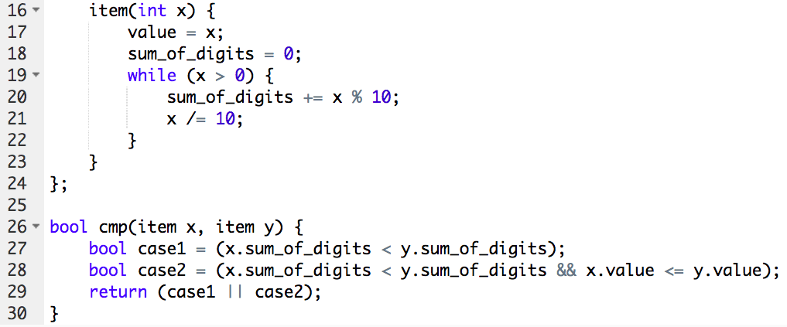
C++ STL Sort - 2

Slide 24
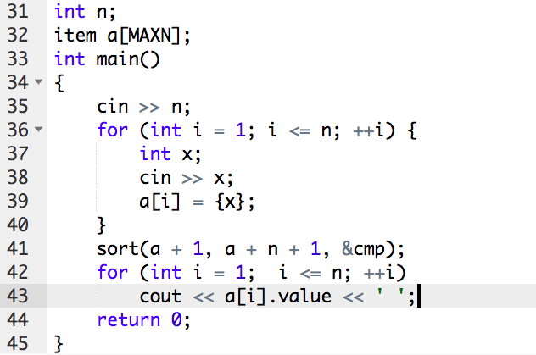
C++ STL Sort - 3

